Slide 1

AI MOVIE RECOMMENDER
by Gal Presil
Date: 27/2/2026

Slide 2
Why This Project?
How do you choose when there are so many options?
Notes:
Addressing Traditional Search Limitations & Enhancing Context Discovery

Slide 3

Problem Definition
The Goal
To develop a movie recommendation platform
based on Ai techniques.
Core Question
Can AI effectively decode user requests to locate and recommend the exact and most suitable movie for them?

Slide 4

Data Understanding
& Preparation

Slide 5

The Data
Data Source
Data Size
~ 5000 Movies
Movie Title
Genres
Overviews
Cast
Ratings
Poster URLs
Platforms
Streaming Details
Keywords

Slide 6
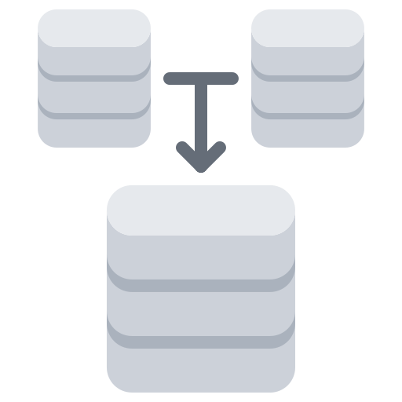


Pre-Processing
Data Merging
Merging datasets into a single, unified Data Frame.
Standardization
Titles are standardized for consistency across multiple sources.
Drop Items
Drop irrelevant columns and check duplicates.
Feature Engineering
Like,
Text Enrichment by aggregation descriptions from all platforms into a single column.
Converting genre lists into a consistent JSON format (20 Genres).

Slide 7
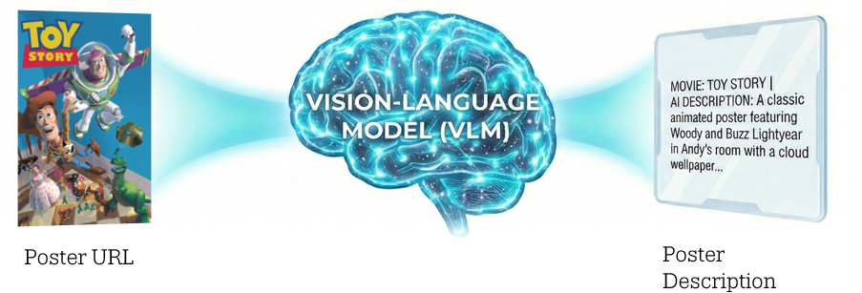
Generate Movie Poster Descriptions
Model: MoonDream2 (Hugging-Face).
Prompting: “Briefly describe this movie poster”.
Hardware: GPU-accelerated (CUDA).
Preprocessing: PIL (Pillow) converts to format compatibility AI model.

Slide 8

Search Function

Slide 9
Hybrid Search Engine
Combines Vector Search (FAISS) for semantic understanding with Keyword Filtering (BM25) for lexical precision.

Slide 10
Step 1:
Semantic Pipeline - Understanding Meaning
Embedding (Sentence Transformers)
Converts the values for each movie into a numerical vector that representing its semantic meaning.
FAISS (Facebook AI Similarity Search)
A library optimized for quickly searching massive sets of vectors.
Acts as an optimized map that instantly finds the nearest neighbours.

Slide 11
Step 2:
Lexical Pipeline - Exact Keyword Matching
Tokenization
Splits the values into individual words (tokens).
BM25
Standard algorithm for keyword-based search.
It scores documents based on two main things:
Term Frequency: how often the searched word appears in a specific movie. | Inverse Document Frequency: how rare the word is across the entire dataset.

Slide 12
Step 3:
Final Polish
Hard Filtering (based the rewriting function)
Combine candidates and apply strict safety/exclusion rules.
Reranking
Judge how relevant a search result is, against the user's original query.
It scores and re-orders them to ensure the absolute most relevant results are pushed to the very top before being presented to the user.

Slide 13

Rewriting Function

Slide 14
Rewriting Function
Search Query Optimizer - “smart translator”
Its main goal is to take a natural language request and use AI to split
into two structured parts that the computer can easily process:
what the user wants (positive)
what they want to avoid (negative).

Slide 15
Step 1:
AI Prompt (Instructions)
The prompt tells the Large Language Model (LLM) exactly what its job is.
Instructions:
1.
Analyse the user message and context
2.
Create the core search terms (positive list)
3.
Create a list of words the user wants to exclude (negative list)
4.
Output Format: Return only a clean JSON object

Slide 16
Step 2:
API Call to AI Model
The function sends the prompt to the AI model.
Model parameters:
Trinity Large Preview model, from Arcee AI
Be consistent and un-creative as possible (temperature=0)
Return a valid json structure (rather than plain conversational text)

Slide 17

Project workflow
RAG

Slide 18
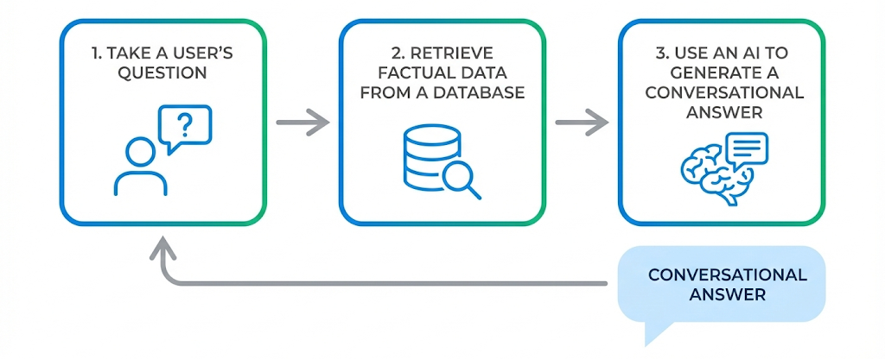
RAG (Retrieval-Augmented Generation)
The system retrieves top-k movie candidates from the vector database and uses an LLM to rank and explain why these specific movies match the user's intent.
Rewritten query
Top-5 movies

Slide 19
Generation Response to the User
AI Model: Trinity Large Preview model, from Arcee AI
Prompts:
Be a little more conversational, creative, and warm, without going entirely off-script (temperature=0.5).
System Prompt: It is instructed to be a "friendly Movie Assistant" and to keep its answers brief (2-3 sentences). | User Prompt: It combines the facts retrieved from your database, with the user's original question.

Slide 20

Evaluation,
Limitations &
Future Work

Slide 21
Retrieval Metrics
Recall@K
66.67% >>> 100% (with Rewrite)
How often the correct movie appeared in your Top-5 search results.
"Toy Story" was initially a miss, with 66.67%, but once you added the AI Rewrite step, Recall jumped to 100%.
MRR (Mean Reciprocal Rank)
0.875
This rewards the system for putting the correct answer at the very top.
A score of 0.875 is excellent, meaning the correct movie is usually the 1st or 2nd result.

Slide 22
Advanced RAG Tests
Context Retention
(The "It" Test)
The AI understands pronouns (it, that, him).
Does the AI remember what we are talking about?
PASS
Multi-Hop Reasoning
Can handle complex, comparative questions.
Can the system connect two different pieces of data?
PASS
Hallucination Resistance
(Negative Constraints)
Will the AI make things up if the movie doesn't exist?
Result: not found exact >> say "Unknown"
PASS

Slide 23
Limitations & Future Work
Constraints:
Future Improvement:
Time and Budget
Expand dataset size
Ensure up-to-date entries
Add information about platforms & posters (currently ~60%)
Improve the prompt in the description of the posters
Run another AI model - verify correctness & evaluate alternatives
Expanding model evaluation tests
Implement chat history (chat context)

Slide 24

User Interface

Slide 25
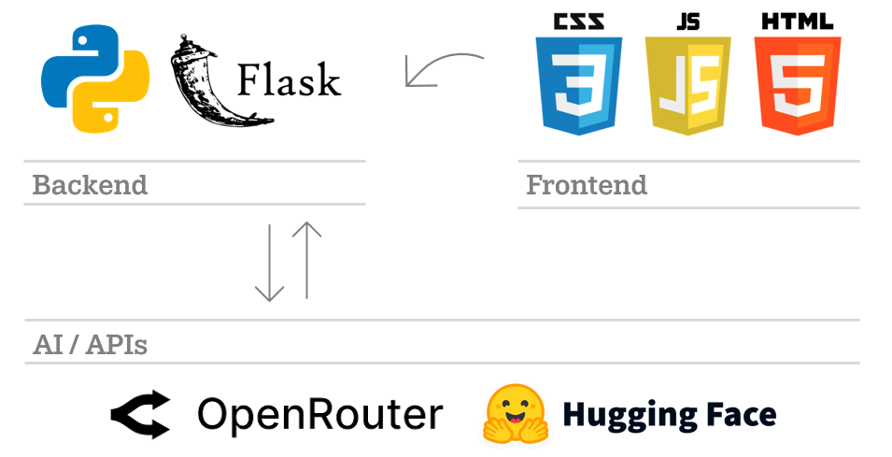
Technologies & System Architecture

Slide 26

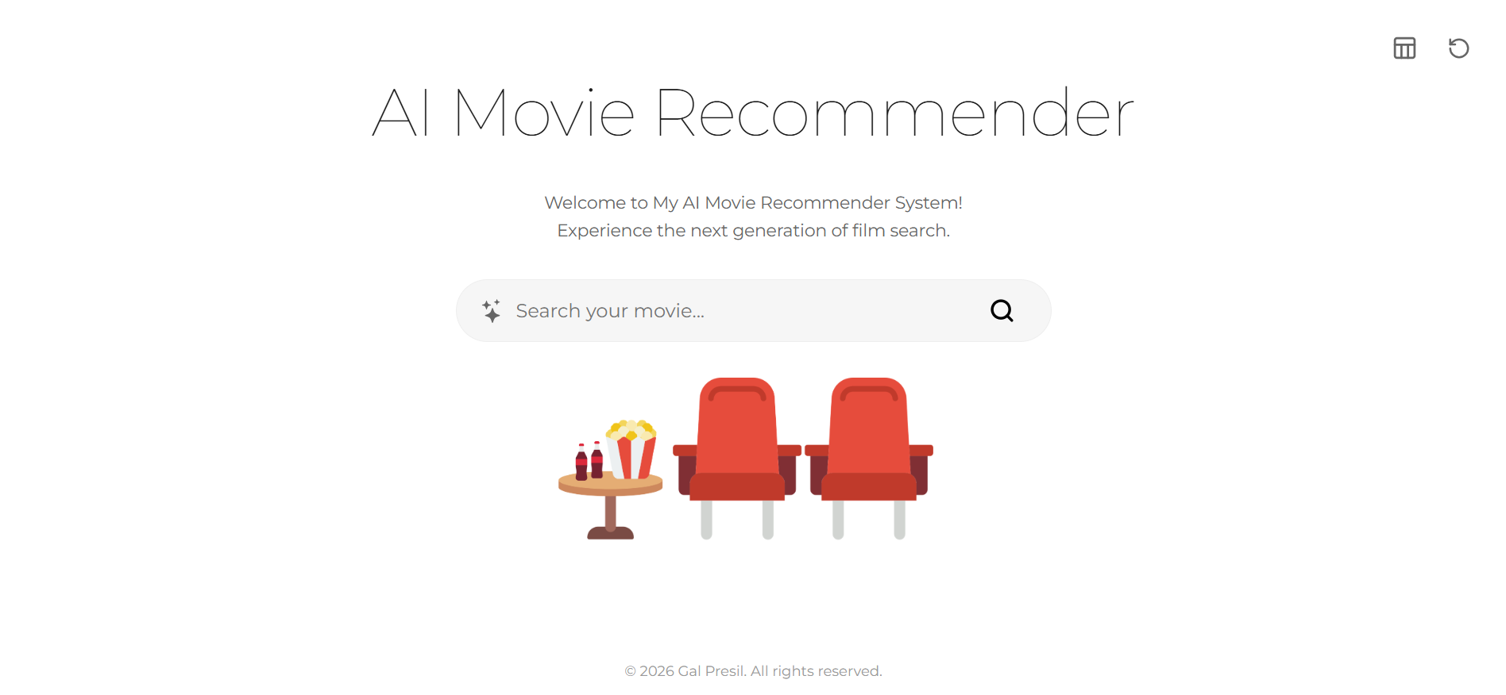
To the Genres page
Restart page button
Artificial Intelligence "Magic" Icon – Hides when the user starts typing, reveals when the box is empty
Start search button (also works when pressing Enter)
The user will write the query

Slide 27
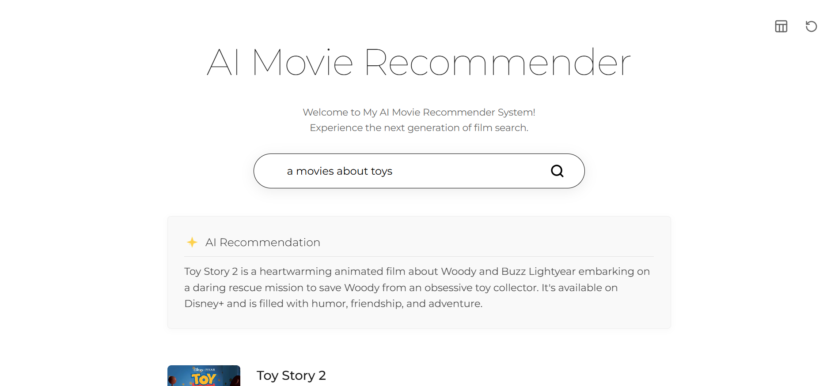
To the Genres page
Restart page button
The AI answer
Start search button (also works when pressing Enter)
Top-5 results

Slide 28
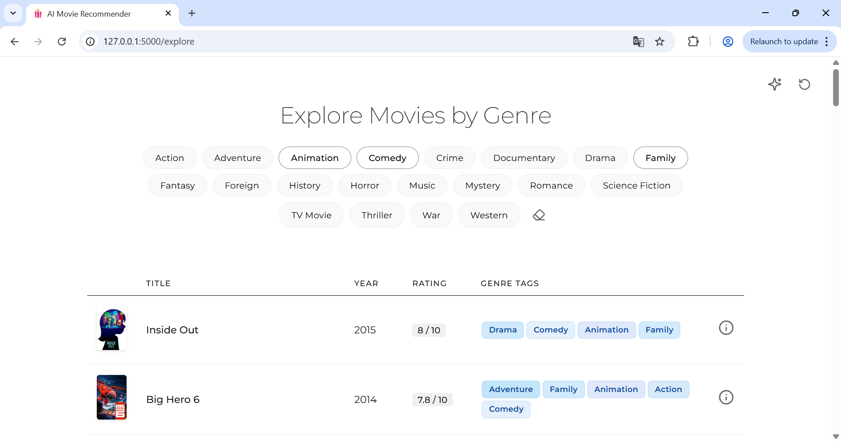
To the AI Search page
Restart page button
Hidden sort buttons (reveals when hover)
Clear all the selected items
Information button

Slide 29




THANKS FOR LISTENING
SCAN ME ^
My LinkedIn
https://www.linkedin.com/in/gal-presil
gal.presil@gmail.com
https://galpresil.github.io/

